Slide 1
Docker and containers

Slide 2
Docker installation
Download the installation file for MAC-OSX.
Download the installation file for Windows.

Slide 3
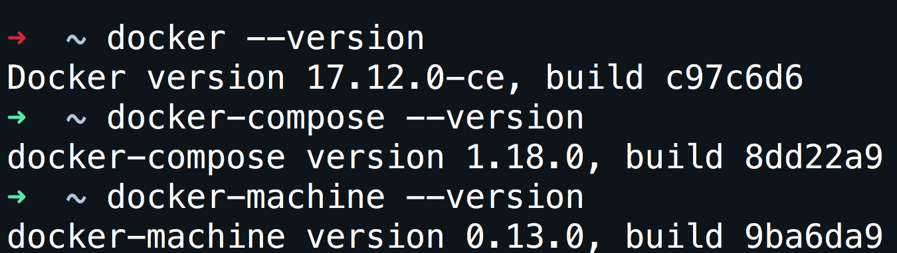
Verify installation
docker --version

Slide 4
Don’t want to install that is ok.
Open your browser and go to: https://labs.play-with-docker.com/

Slide 5
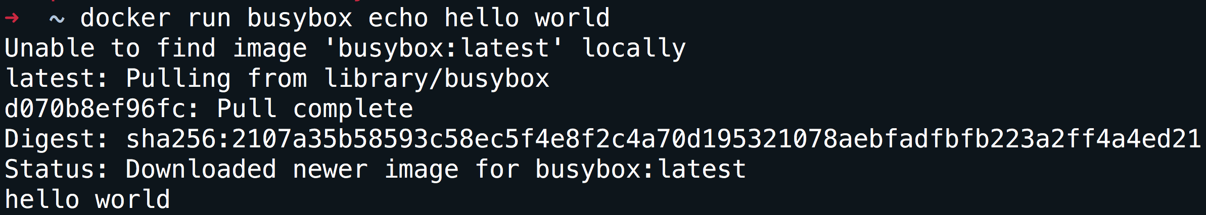
Run your first container
docker run busybox echo hello world

Slide 6
What did we just do
We download the smallest and simplest image from a repo.
We executed the command hello world.

Slide 7
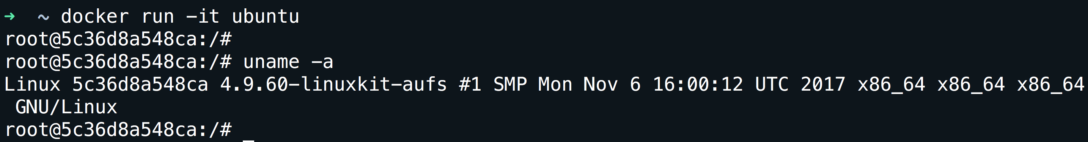
A more useful container
docker run -it ubuntu
-it is shorthand for -i -t.
-i tells Docker to connect us to the container's stdin.
-t tells Docker that we want a pseudo-terminal.
Go ahead and try something inside the container.

Slide 8
A few concepts
Containers.
Images.
Network.
Volumes.
How does it compare with VMware.

Slide 9
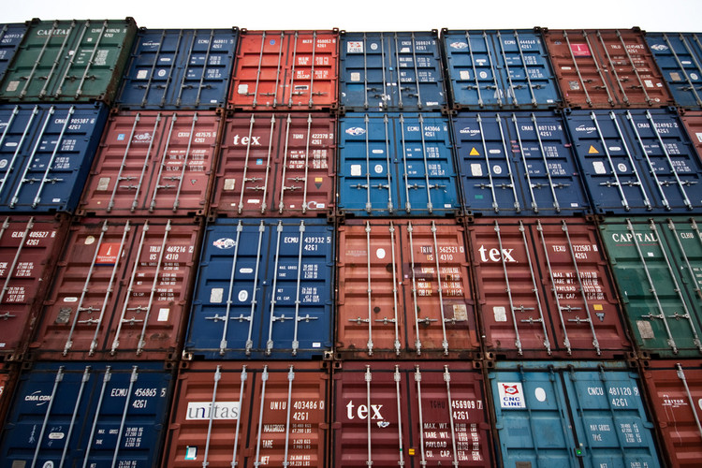
CONTAINERS

Slide 10
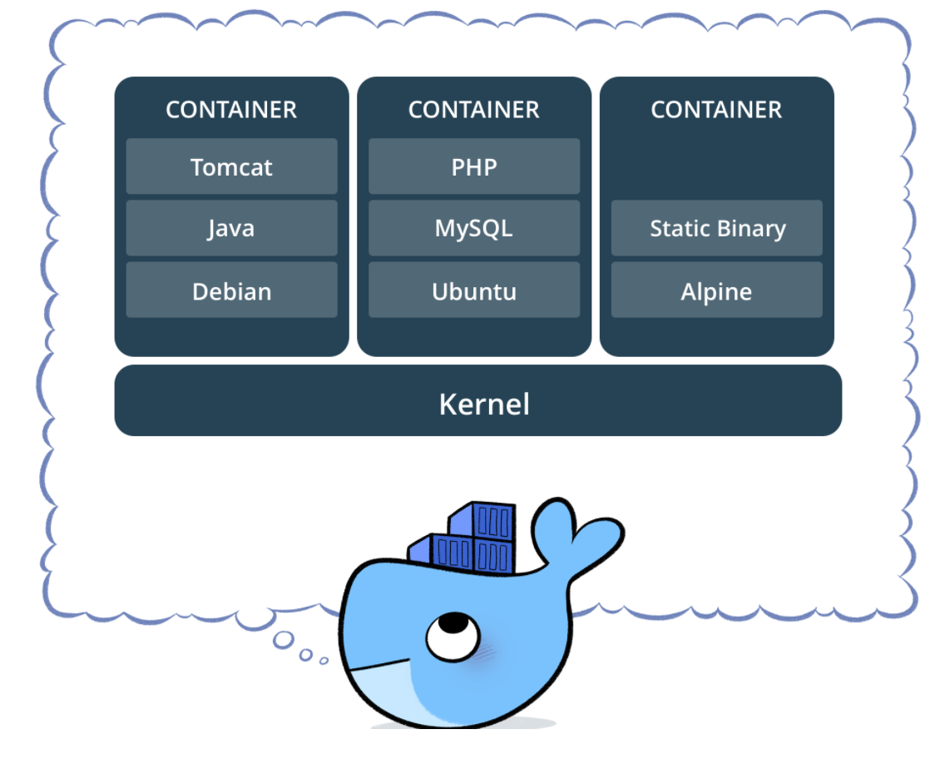
What is a container
A container image is a lightweight, stand-alone, executable package of a piece of software that includes everything needed to run it: code, runtime, system tools, system libraries, settings.
Is a process.

Slide 11
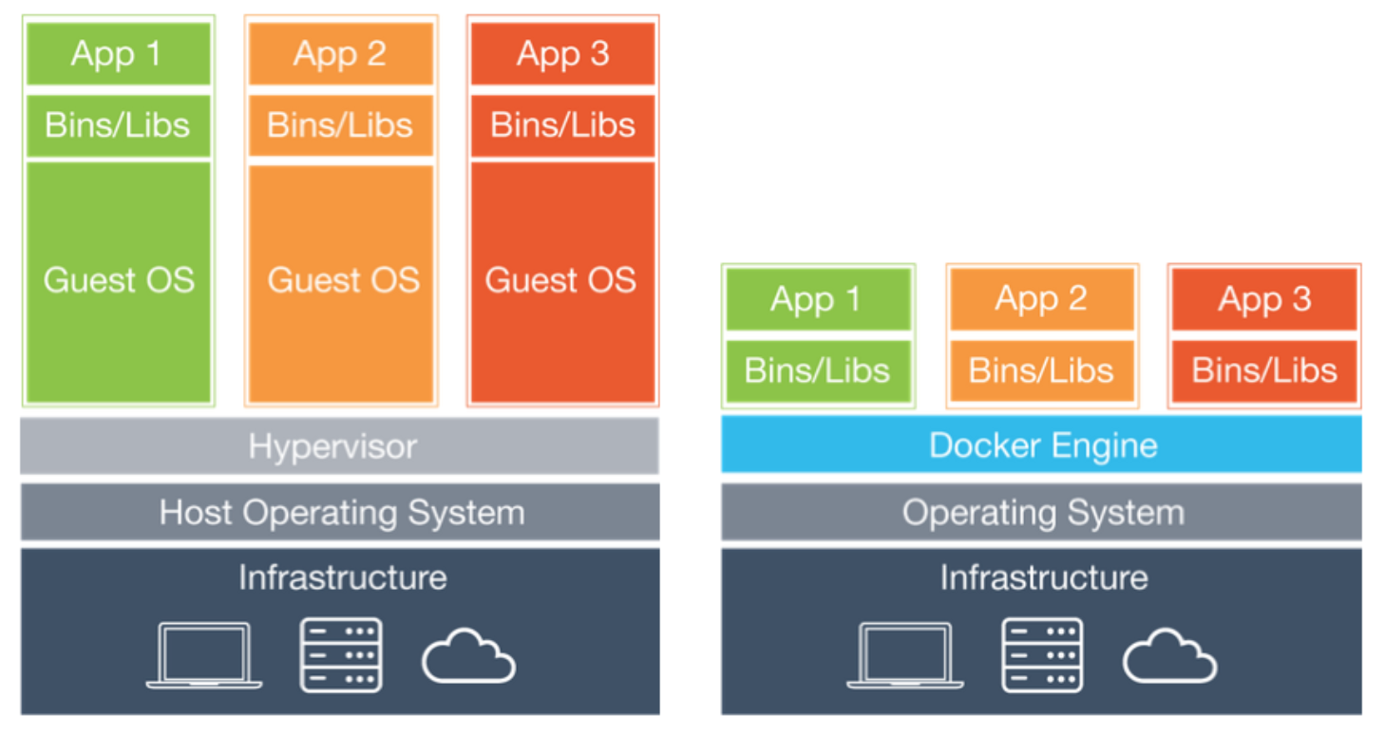
How does it compare with Vmware?
A container is comparable with a VM.
The container is faster to boot, has smaller footprint, is more portable.
Containers are by their nature transitory and disposable.
The VM creates a virtual hardware while the container virtualize the operating system.
It runs only one process.

Slide 12
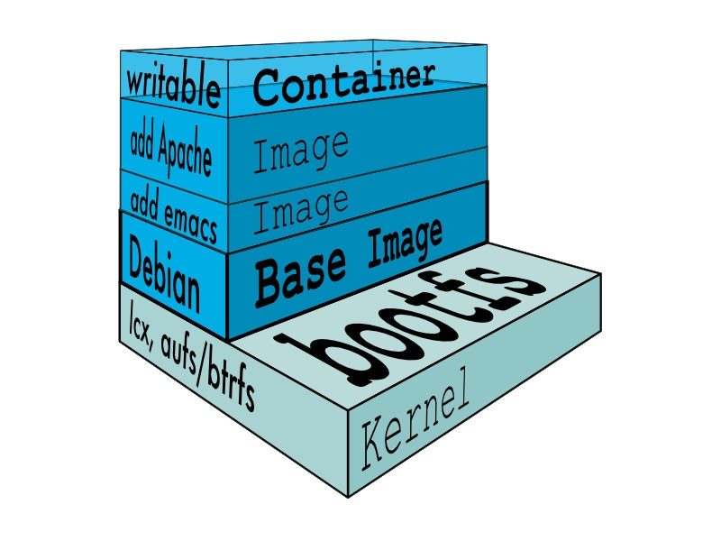
IMAGES

Slide 13
Images
What is an image.
What is a layer.

Slide 14
What is an image
Image = files + metadata
Images are made of layers, conceptually stacked on top of each other.
Each layer can add, change, and remove files and/or metadata.
Images can share layers to optimize disk usage, transfer times, and memory use.
The images are a read-only filesystem.

Slide 15
Object-oriented programming
Images are conceptually similar to classes.
Containers are conceptually similar to instances.

Slide 16
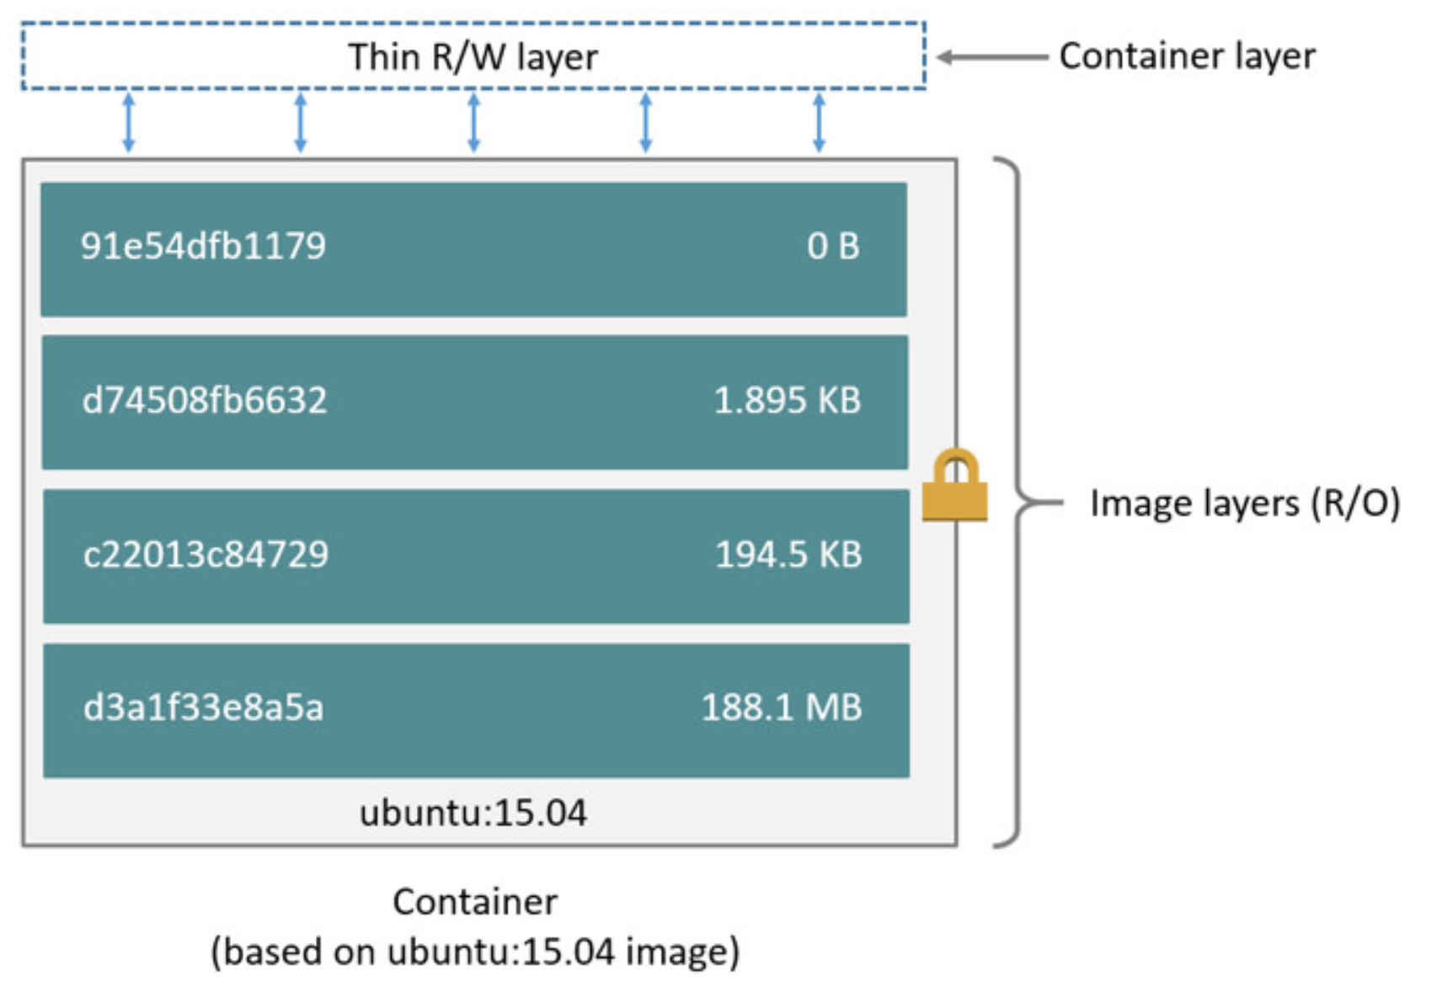
How an image looks like

Slide 17
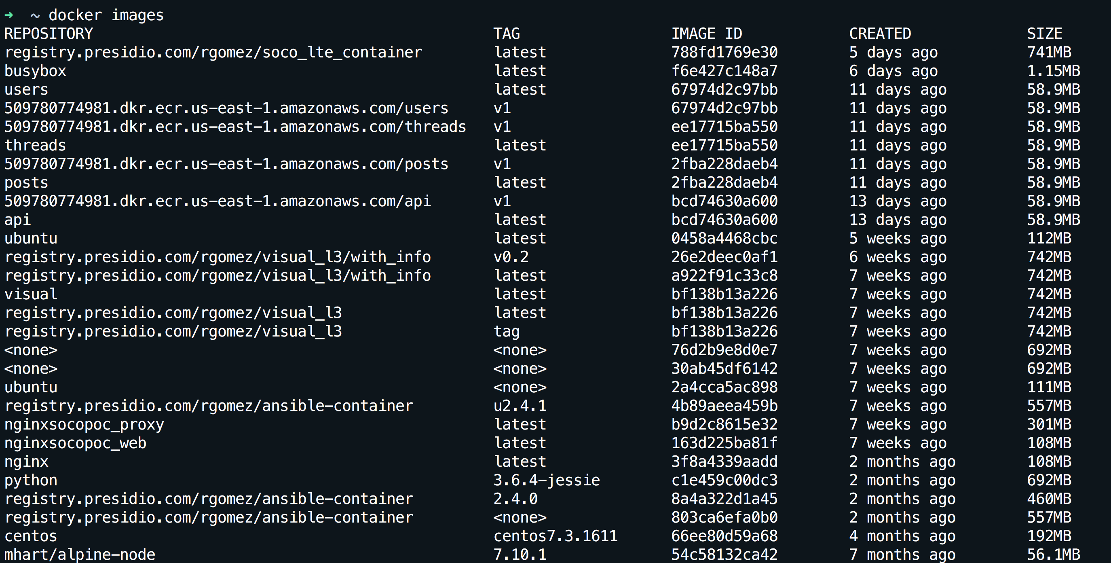
How can I see my images
docker images

Slide 18
How does it compare with VMware?
The Docker image is comparable to a VM template.
The image is smaller footprint, and is more portable.
Example:
Always use a template to create VMs, do not update the VM only update the template, and dispose old VMs.
This is how Docker works, there is no need to update the container, always update or create a new image and launch containers from it and dispose old containers.

Slide 19
How do we update an image
docker commit
Saves all the changes made to a container into a new layer.
Creates a new image (effectively a copy of the container).
docker build
Performs a repeatable build sequence.
This is the preferred method!

Slide 20
Dockerfile
vi dockerfile
Inside the file copy:
FROM ubuntu
RUN apt-get update
RUN apt-get install figlet
Save the file
docker build -t figlet .
docker images
docker run -ti figlet figlet HELLO

Slide 21
Extending Dockerfile
If the container is normally one process can we add that process into the image?
Using CMD and ENTRYPOINT.
These commands allow us to set the default command to run in a container.

Slide 22
New Dockefile with processes
To the previous dockerfile add at the end:
CMD figlet HELLO
Save the file.
docker build -f dockerfile-cmd -t figlet-cmd .
docker run -ti figlet-cmd

Slide 23
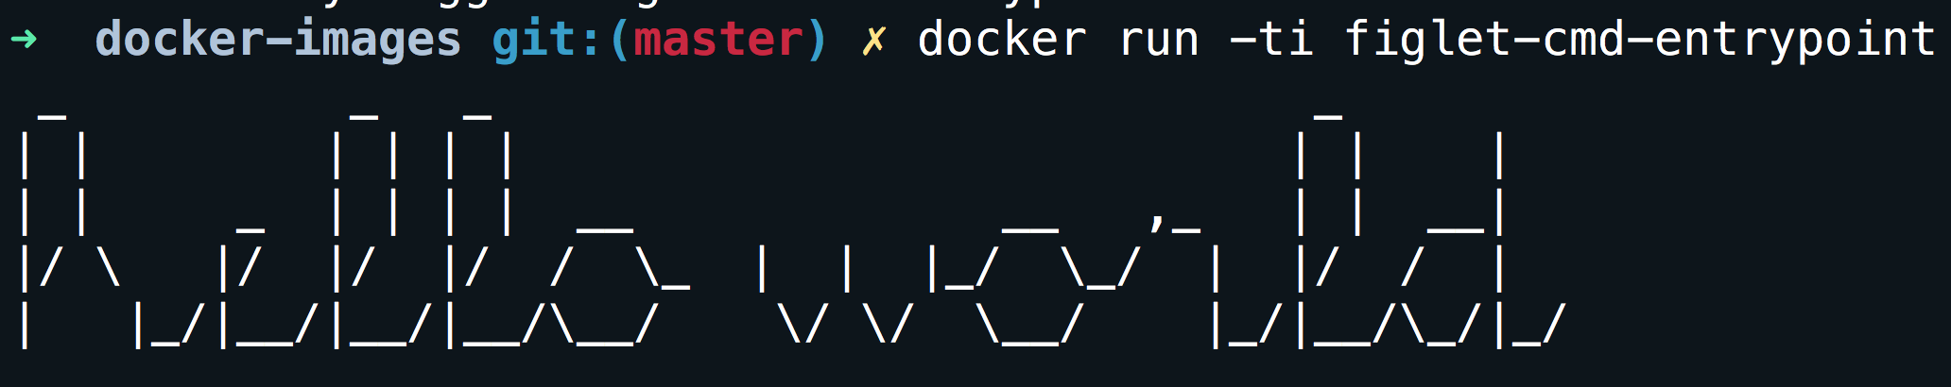
CMD vs ENTRYPOINT
CMD is the last resort to execute a process, if no process is specified during the container creation (docker run -it figlet bash) or no ENTRYPOINT is specified the CMD process is used.
CMD can complement ENTRYPOINT, if both are specified the ENTRYPOINT is the command while the CMD is the argument of the command. For example using:
ENTRYPOINT ["figlet", "-f", "script"]
CMD ["hello world"]
Is going to print:

Slide 24
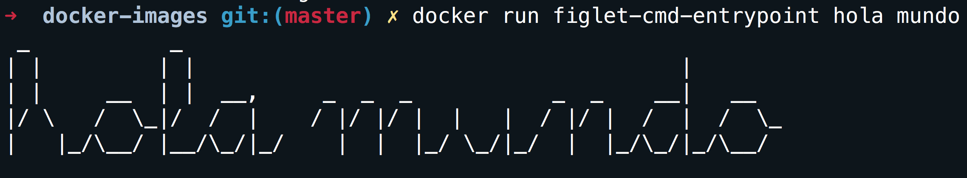
Overriding parameters
Executing docker run -ti figlet-cmd-entrypoint hola mundo on the same image:

Slide 25
How do I copy my files
What good is a container if we can not copy our own files.
For the purpose the COPY SOURCE DESTINATION command exist.
A build context is needed
IMPORTANT: the build context is the directory containing the Dockerfile.

Slide 26
NGINX image
Create a new dockerfile-nginx with the following information:
FROM nginx:1.13-alpine
COPY nginx-conf/index.html /usr/share/nginx/html/
Create a new directory:
mkdir nginx-conf
Create an index:
echo "HELLO PRESIDIO" >> nginx-conf/index.html
Build the image and name the image mynginx.
docker build -f dockerfile-nginx -t mynginx .

Slide 27
Say HELLO PRESIDIO
Run the image:
docker run -d -P --name web1 my_nginx:latest
Find the port:
docker port web1
Go to your browser:
http://localhost:<PORT>

Slide 28
Don’t lose your image, share it.
Login to dockerhub
docker login
Use the correct tag in your container:
docker tag mynginx dockerhub_username/test_nginx:v1
Push your container:
docker push dockerhub_username/test_nginx:v1
Delete your image from your hard-drive.
docker image rm dockrehub_username/test_nginx:v1
Verify the image is not longer present:
docker images
Download the image again:
docker pull dockerhub_username/test_nginx:v1

Slide 29

NETWORK

Slide 30
Network in a container
The most common network technique we are going to see is port mapping (NAT).
The flag -P will tell the container that publish all ports defined on the image. This will be assigned to random ports.
The option -p host_port:docker_port, can be used to statically define a port mapping. Be aware of port conflicts.

Slide 31
Network drivers
bridge (default): each container will get an eth0 and a loopback. The default network should be 172.17.0.0/16 but it can be changed with –bip option.
none: only a loopback, no traffic in or out.
host: using the option --net host, the container will share the host network stack.
container: using the option --net container:id, the container will share with another container the network stack.

Slide 32
What network means to a container
Is network just a “virtual switch”??
Create a new network:
docker network create my_test
Create a container in the new network:
docker run -d -P --name web3 --net my_test nginx
Create another container:
docker run -ti --rm --name test_node --net my_test alpine ping web3
Did we configure name resolution?
docker run -ti --rm --name test_node --net my_test alpine cat /etc/resolv.conf
Who is 127.0.0.11?

Slide 33
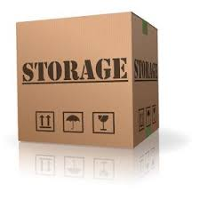
STORAGE

Slide 34
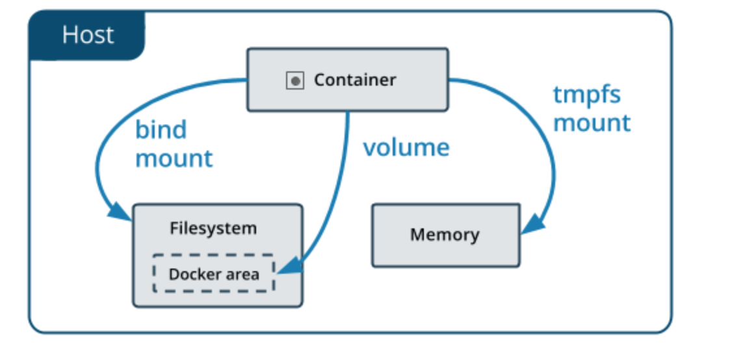
Storage for containers
There are tree storage types:
Volumes.
Binds.
Tmpfs.

Slide 35
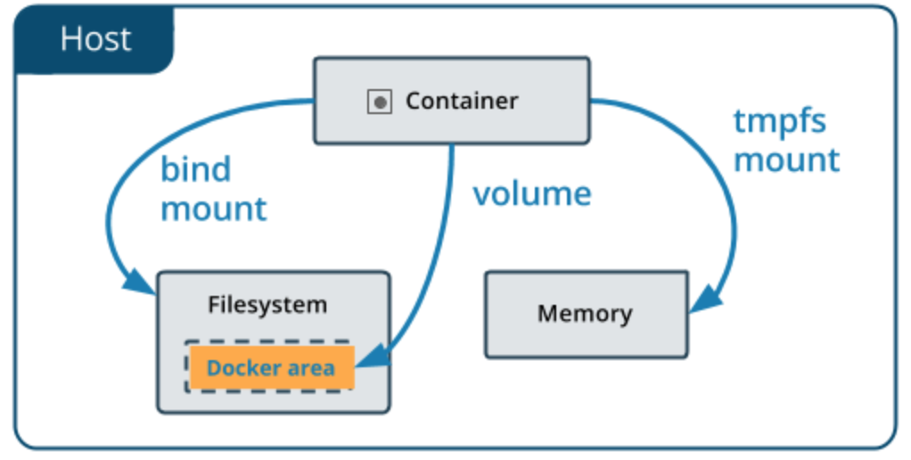
Containers and volumes
Volumes are specially designated directories within one or more containers that bypass the layered File System to provide persistent or shared data for Docker.
The volume exist Docker’s storage directory on the host machine.

Slide 36
Containers and volumes
Create a volume.
docker run -ti --rm -v new_vol --name test_volume alpine sh
Check the new volume inside the container.
df –h
Create a file on that volume.
echo 'this is a test' >> /new_vol/test.txt
Create another container with same volume.
docker run -it --rm --volumes-from test_volume --name test_volumne_1 alpine sh
Verify the file created in the other container exist.
cat /new_vol/test.txt

Slide 37
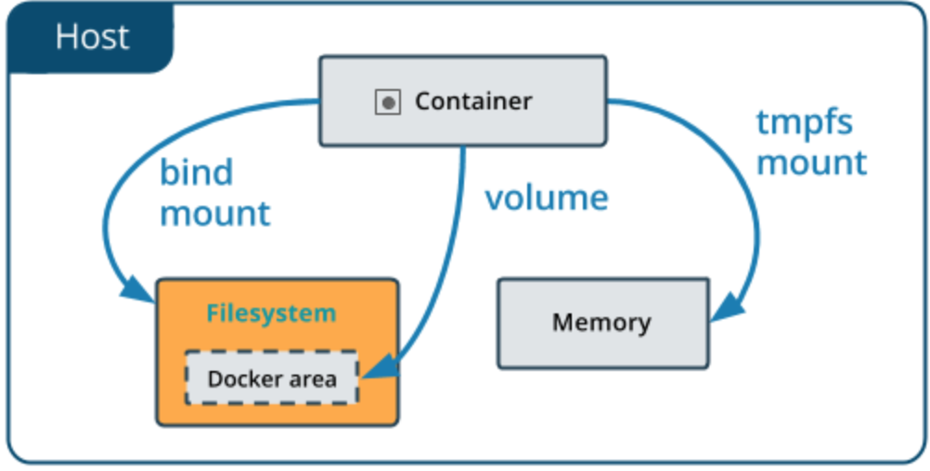
Containers and bindings
Bind mounts have limited functionality compared to volumes.
When you use a bind mount, a file or directory on the host machine is mounted into a container.

Slide 38
Containers and bindings
Create a directory.
mkdir my_bindings
Create a file inside the directory.
echo "bind test" > my_bindings/test.txt
Run a container.
docker run -it --rm -v $PWD/my_bindings:/new_vol1 --name test_bind_1 alpine sh
Inside the container verify the file.
cat new_vol1/test.txt
Edit the file.
echo "Another line" >> new_vol1/test.txt
Exit the container.
exit
Check the file again.
cat my_bindings/test.txt

Slide 39
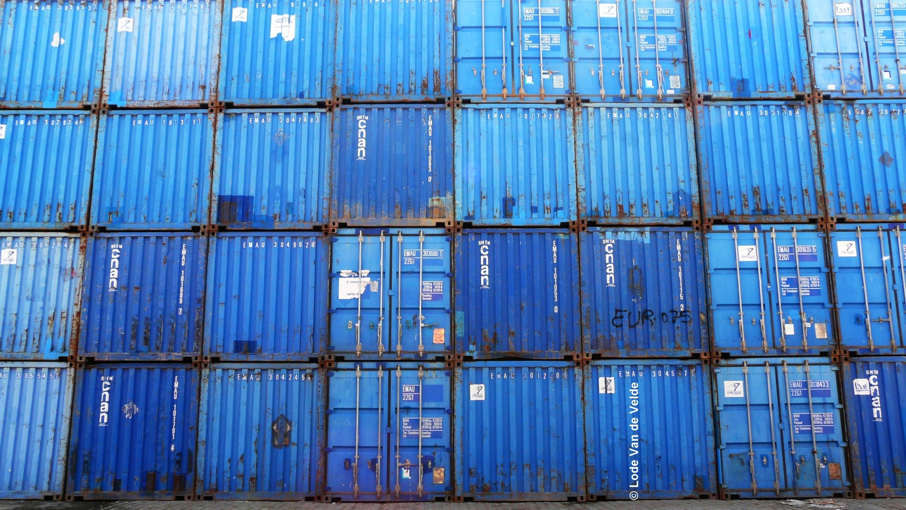
THE COOL STUFF

Slide 40
Why do we care about containers?
We can do everything that containers can do without them?
Why we cannot continue doing things in the same way?
Why do we need another layer?
Why…why…why???

Slide 41
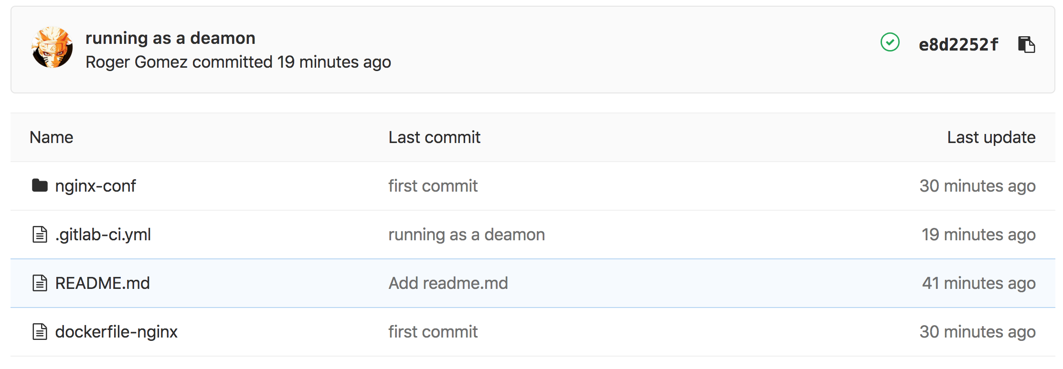
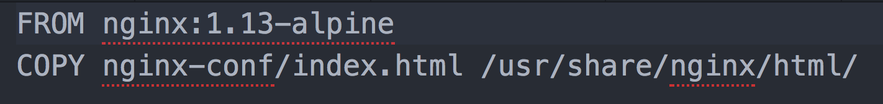
Developers love containers
cd/ci
CD/CI
cd/ci
Image
image
The container (AKA infrastructure) is part of the code

Slide 42
Git + Containers
Every new git push will trigger one or more workflows.
That workflow can:
Build the new image.
Push the image to a registry.
Run a container from that image.
Test the container.
Deploy the container to production. (Normally a manual process)

Slide 43
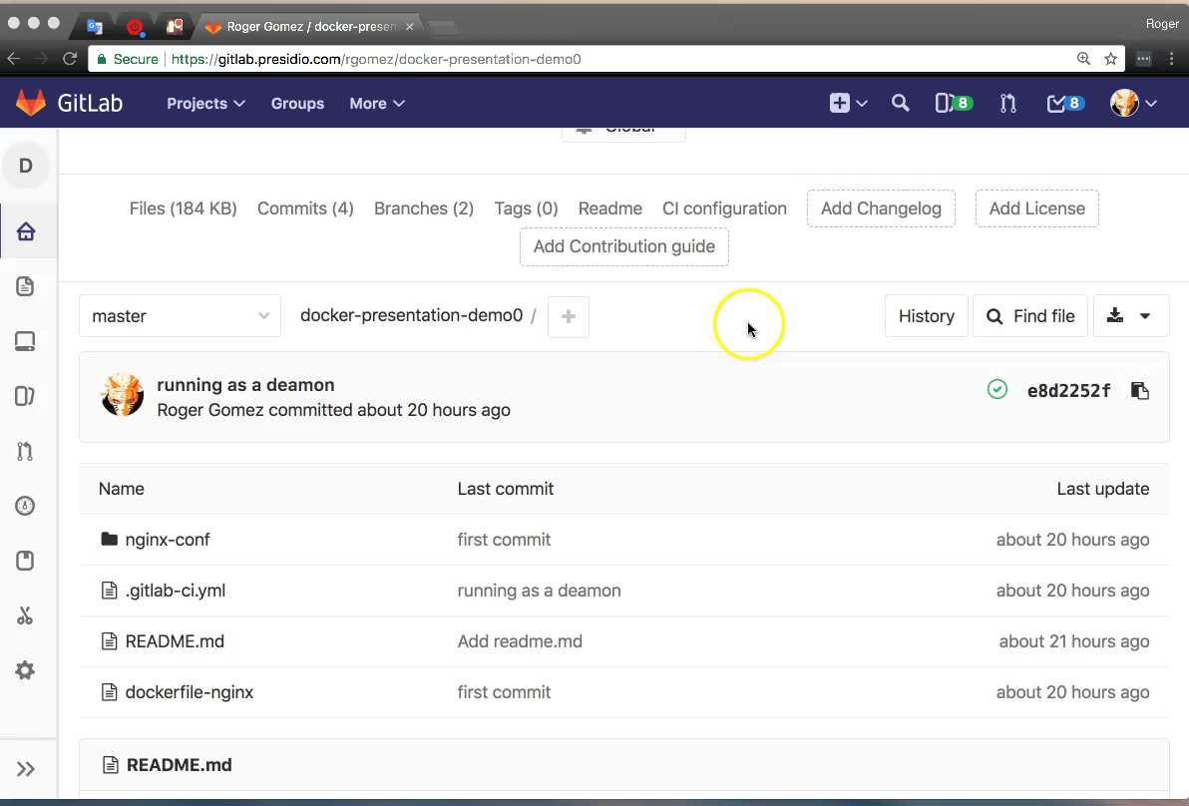
Git + Container

Slide 44

Update your code

Slide 45
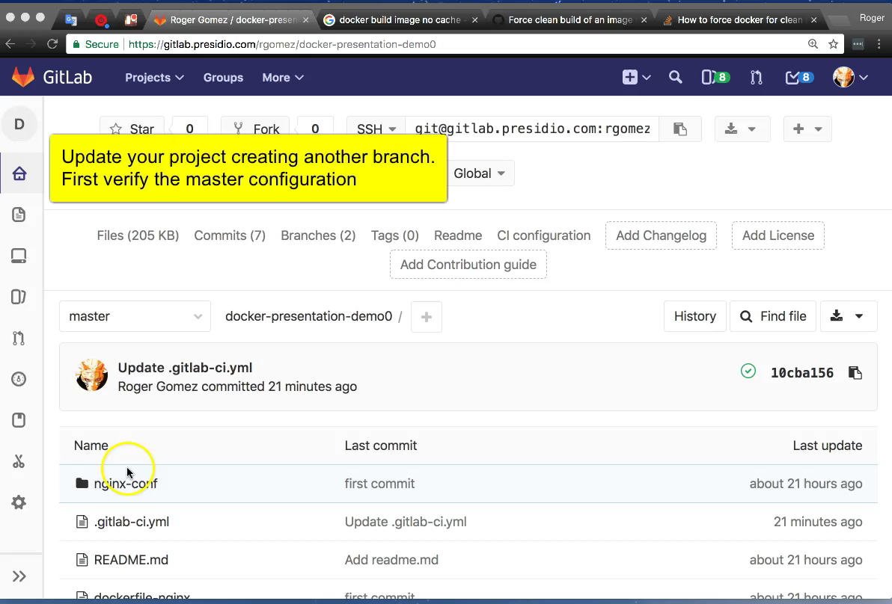
Update your code

Slide 46
In software, when something is painful, the way to reduce the pain is to do it more frequently, not less.
– David Farley

Slide 47
Why developers like containers?
They integrate with CD/CI very well.
They can automate the infrastructure.
They can easily distribute not just code but infrastructure.
The application is packaged inside a container.
They infrastructure is just a piece of code now.

Slide 48
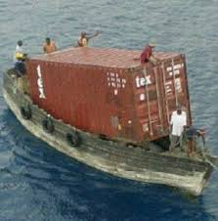
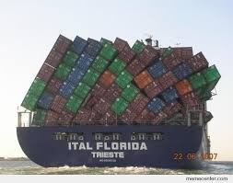
Why do we care about containers?
We need to help our customers

Slide 49
How can we help with containers.
The following example is a simple two layer app.
The Web layer using flask.
Initially the Web layer has only two containers.
Each request will return the container ID and the number of request this container has served.
The Web layer will be distributed across multiple host in different subnets.
The DB layer using Redis.
I said multiple host in different subnets.

Slide 50
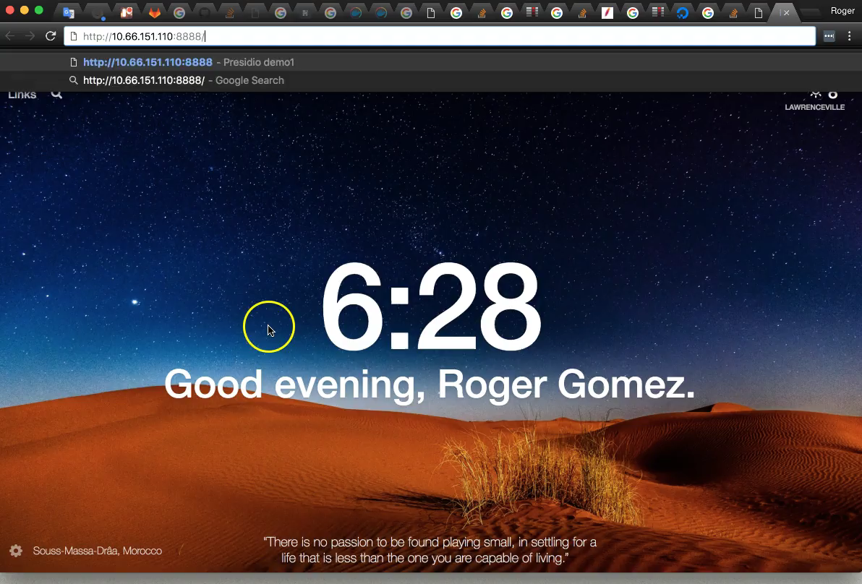

Slide 51
Is Docker working as a load balancer?
YES

Slide 52
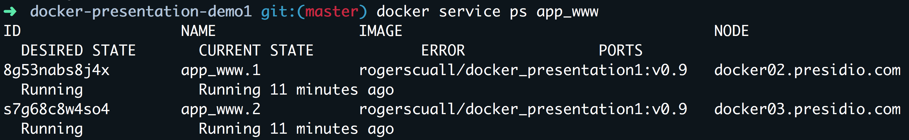
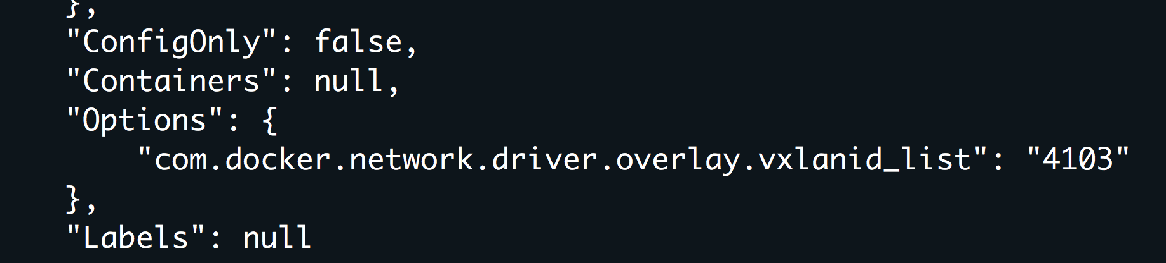
Same subnet across different L3, what is that?
Another hint?

Slide 53
Is Docker working as a VTEP?
YES

Slide 54
Can I connect directly to the DB?
Only the web server
can connect to the DB.
And yes, before you ask is
also working as a firewall
NO

Slide 55
AWS how do you call this?

Slide 56
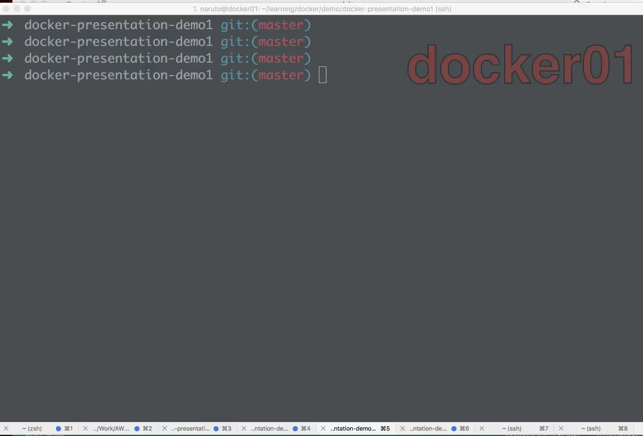

Slide 57
One more for fun…

Slide 58
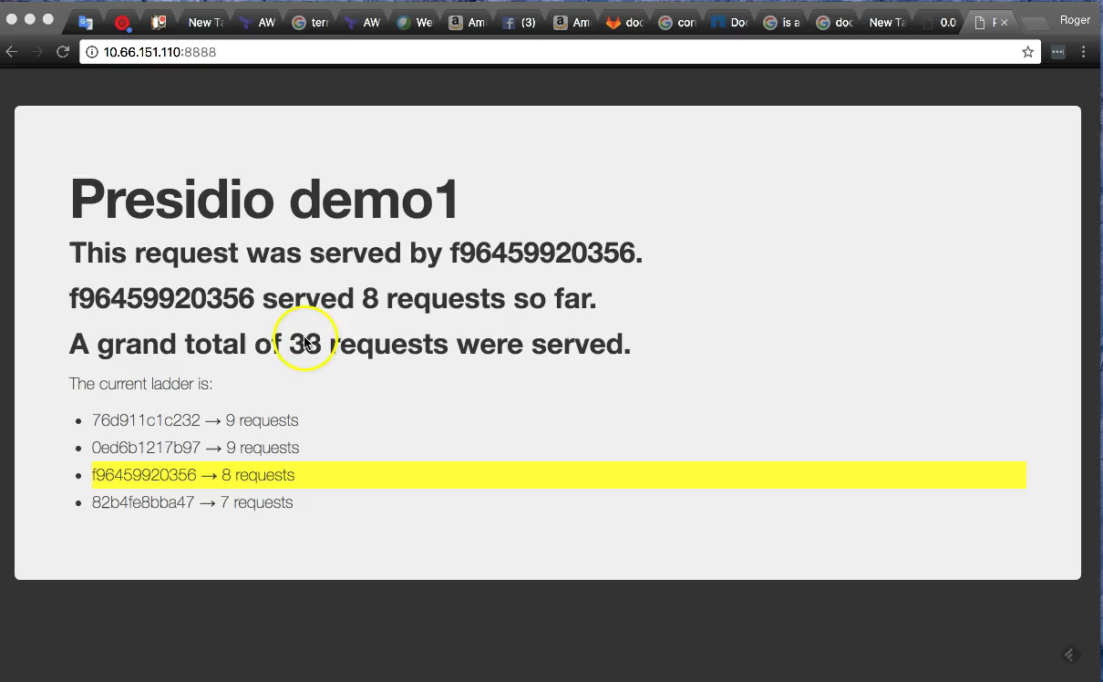

Slide 59
Update and rollback?

Slide 60
